Slide 1

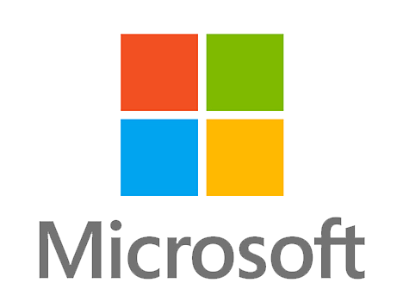
MICROSOFT
THE HISTORY OF MICROSOFT
By Ripley

Slide 2
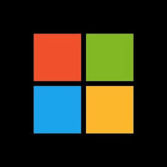
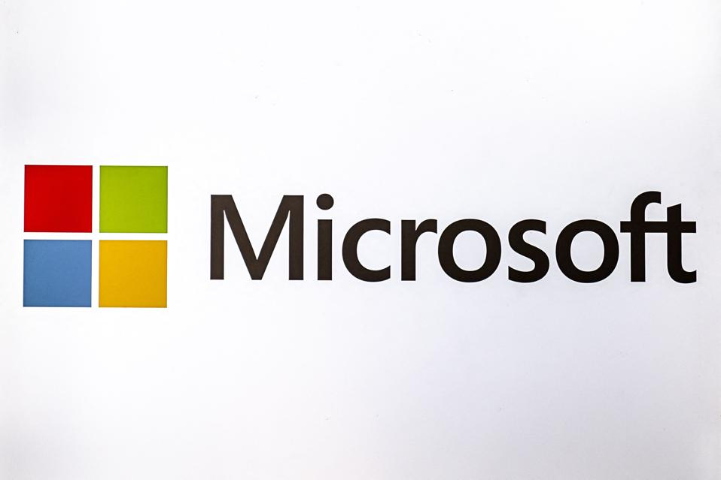
The Founder of Microsoft
The Founder of Microsoft are two men, Bill Gates, and Paul Allen. They started the the corporation in Albuquerque, New Mexico.
They created or established this corporation on April 4, 1975.

Slide 3
Industry of Microsoft
Microsoft primarily operates within the technology sector, with a strong focus on computer software. They are a leading American multinational company known for developing and supporting software, services, devices, and solutions.

Slide 4
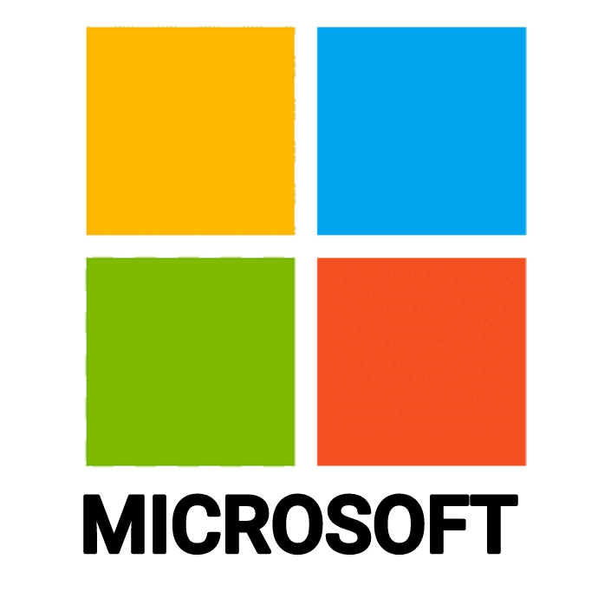
Is Microsoft publicly traded?
“Yes” is the answer
$512.62 one stock is this much money

Slide 5
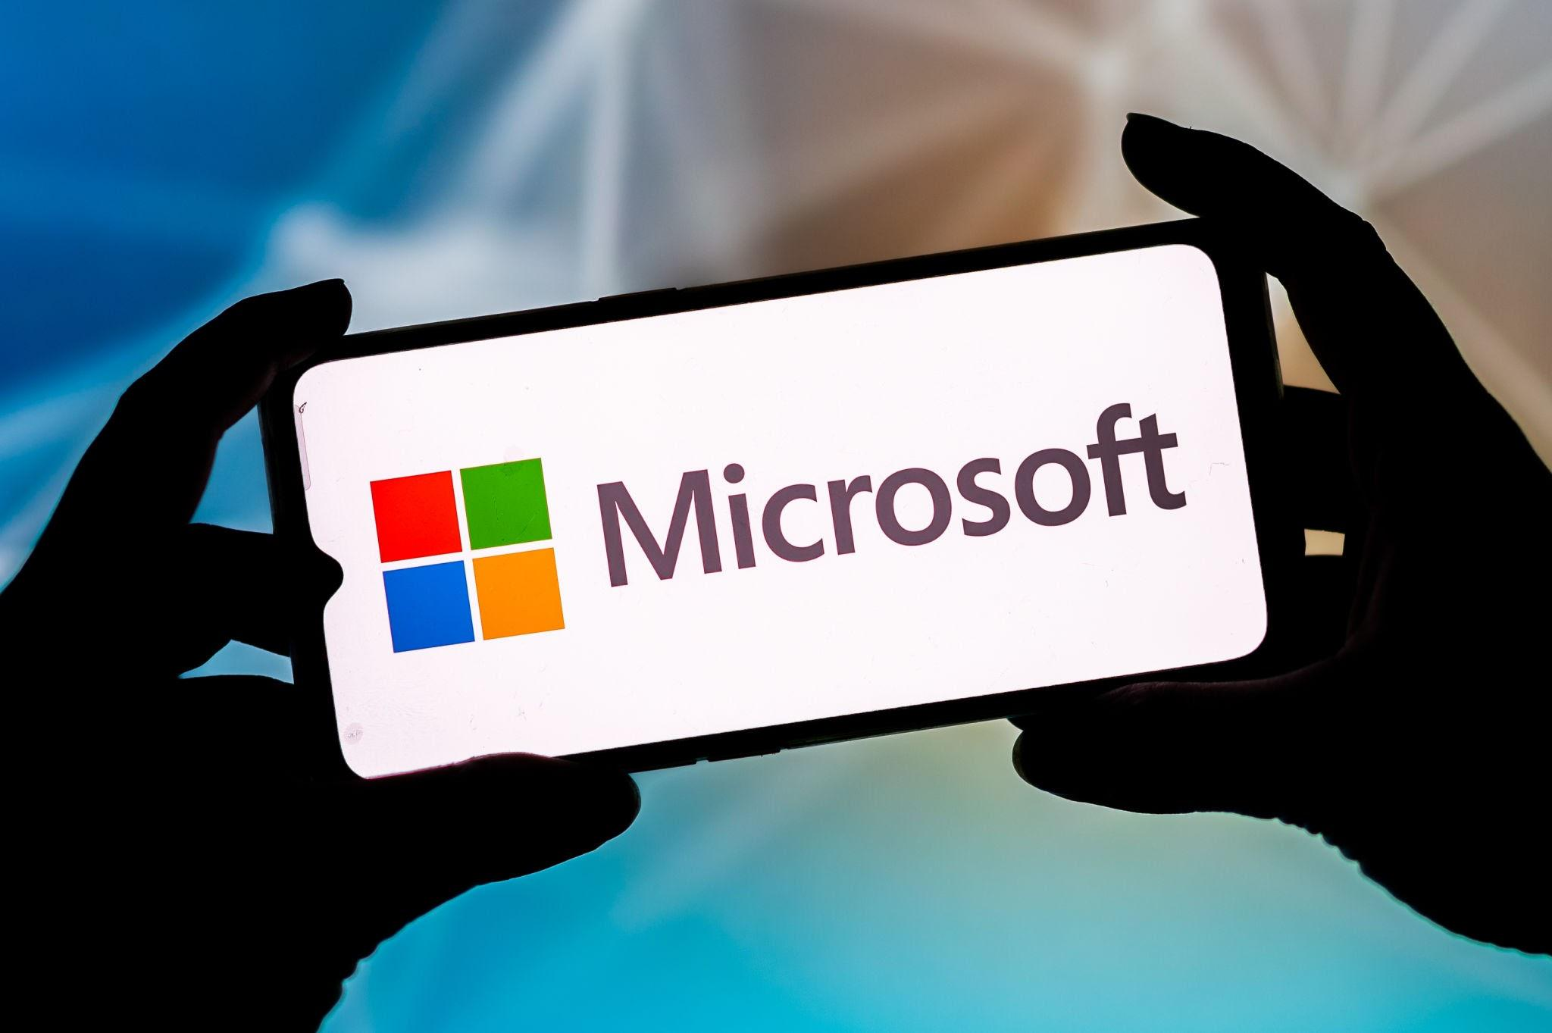
Is the corporation producing revenue?
Yes, Microsoft is a highly profitable company that generates a significant amount of revenue from a diverse range of products and services.
$168.1 billion

Slide 6
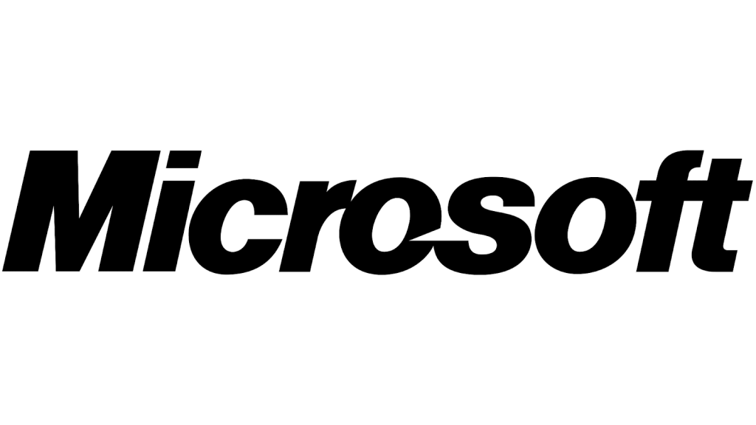
Fun Facts
It started in a garage, and named was first named “Micro-Soft"
The company almost missed out on acquiring YouTube.
The current logo, introduced in 2012, features four colored squares and the company name.
The fourth Microsoft logo was nicknamed "Pac-Man"

